Slide 1
NEURAL NETWORK DEMO
Ondertitel indien nodig

Slide 2
In this presentation
Building a neural network and training it
Start with a linear model
Spread it out amongst multiple “neurons”
Add an activation function

Slide 3
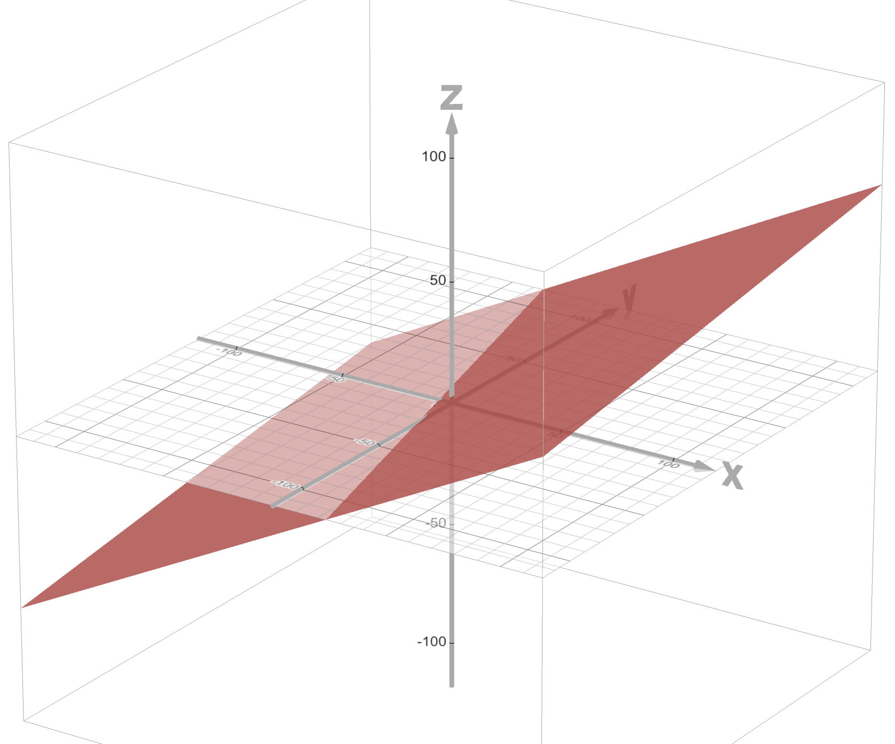

Situation
Two feature variables, $x$ and $y$
One output variable, $z$
Formula: $z=ax+by$(ignore $+c$ for now)
We’re looking for the values of $a$ and $b$.
In English: how much of variable $x$ do we need and how much of variable $y$ to predict variable $z$?

Slide 4
Training data
x | y | z
1 | 2 | 8
2 | 2 | 10
3 | 3 | 15
3 | 4 | 18

Slide 5
The network
This is a simple case of linear regression, of course. Don’t worry, we’ll add an activation function later.
Let’s create a simple network:
Training data
F(x, y) = ax + by
Score

Slide 6
Let’s train
In reality, of course, we train using multiple observations – and it will not always be so simple!
x | y | a | b | pred | z | score
1 | 2 | 1 | 1 | 3 | 8 | -5
1 | 2 | 2 | 2 | 6 | 8 | -2
1 | 2 | 3 | 3 | 9 | 8 | 1
1 | 2 | 2 | 3 | 8 | 8 | 0 !

Slide 7
How well did our training session go?

Slide 8
The network: let’s spread things out
In practice, most calculations are too complicated to do in a single “cell”.
Let’s change our network to reflect this practice.
F(x) = ax
Score
F(d, e) = d + e
Training data
F(y) = by

Slide 9
Training the spread-out network
We’re getting close to the real result, but we never really get there. With real data, this is often the best we can do (as reality does not often conform to neat mathematical formulas)
x | y | a | b | pred | z | score
1 | 2 | 1 | 1 | 3 | 8 | -5
1 | 2 | 2 | 2 | 6 | 8 | -2
1 | 2 | 3 | 3 | 9 | 8 | 1
1 | 2 | 2.5 | 2.5 | 7.5 | 8 | -0.5
1 | 2 | 2.75 | 2.75 | 8.25 | 8 | 0.25
1 | 2 | 2.6 | 2.9 | 8.4 | 8 | 0.4
1 | 2 | 2.7 | 2.6 | 7.9 | 8 | -0.1
1 | 2 | Etc | Etc | Etc | 8 | Etc

Slide 10
Graph the training session again
As you can see, we get close to the correct value but never quite reach it.
We can also see the model stops improving meaningfully after iteration 3.
In AI / ML we use the fact that the performance score “flattens out” to decide when to stop training.

Slide 11
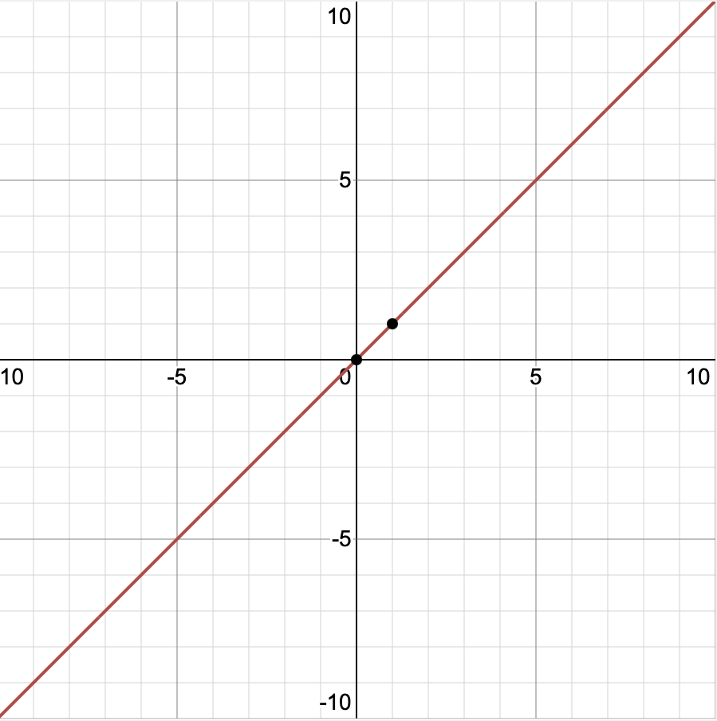
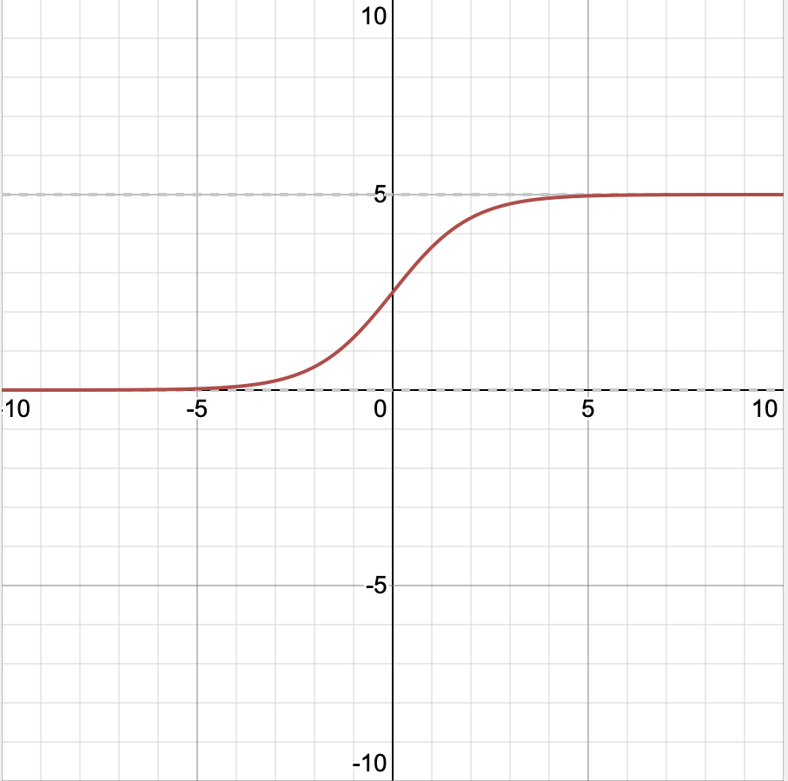
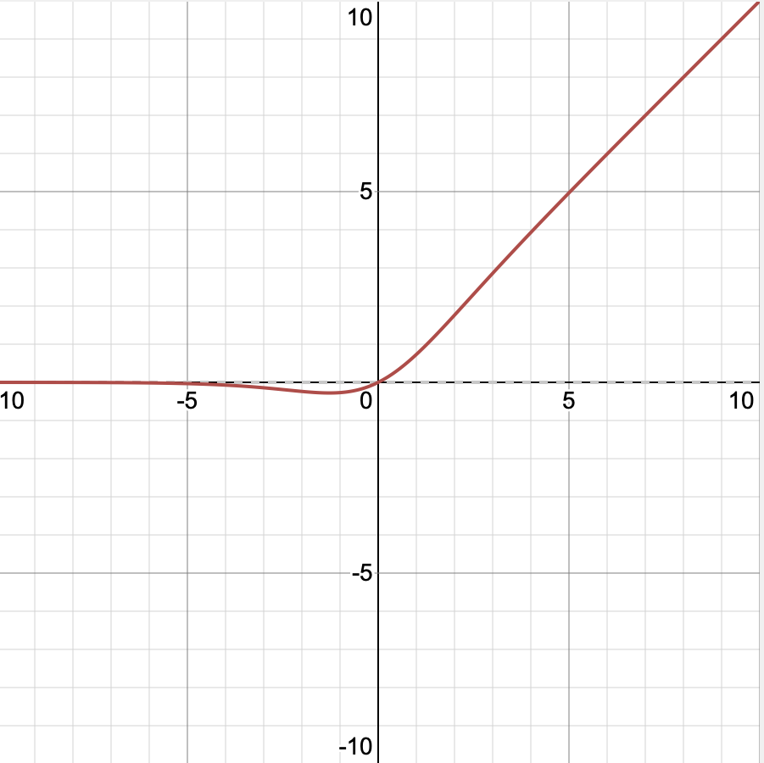

Moving towards a curve: adding an activation function
Until now we have trained a linear model ($z=ax+by$). We could (and should) have done this with simple linear regression, of course.
However, most problems are not linear.
It turns out, you can approximate any curve you want using a combination of a linear function and an activation function.
Let’s change our model from: $z=ax+by$for $x>c$only (meaning 0 for $x≤c$)
+
=
f(x) = x
g(x) = 1/(1 + e^{-x})
f(g(x))

Slide 12
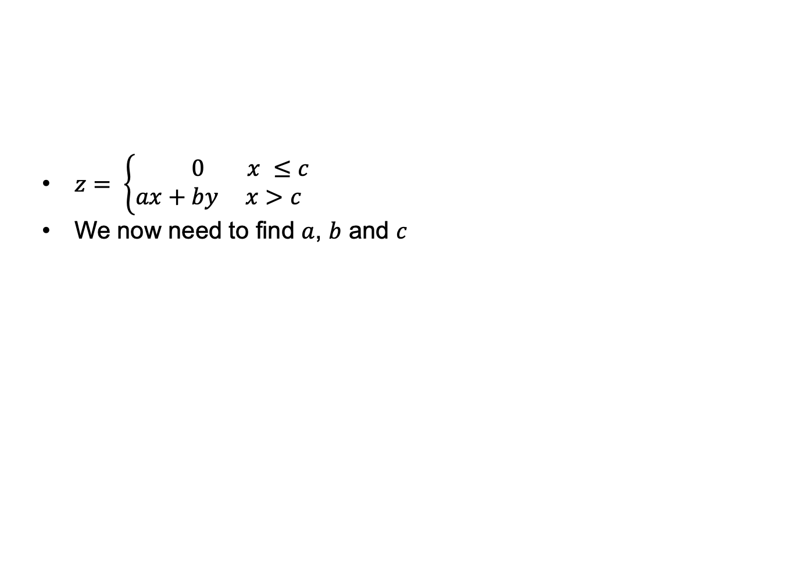
Training data for the neural network
$z= \left\{\begin{aligned} 0 x ≤c \\ ax+by x>c \end{aligned}\right.$
We now need to find $a$, $b$ and $c$
x | y | z
1 | 2 | 0
2 | 2 | 0
3 | 3 | 15
3 | 4 | 18

Slide 13
The network inc. activation function
We need to know beforehand which activation function to use.
The activation function needs to be connected to the input of the network as a whole.
The activation function ignores the y parameter (in this case).
F(x) = ax
Training data
Score
F(x, y, d, e) =
d + e (if x > c)
0 (if x <= c)
F(y) = by

Slide 14
Training the neural network inc. activation function
Training the neural network with the activation function works the same as without. There’s just more numbers to crunch.
Spreading out calculations among multiple “neurons” allows performing them in parallel on specialized hardware (GPUs or TPUs)
GPU: Graphics Processing Unit
TPU: Tensor Processing Unit: device optimized for large collections of numbers (“Tensors”).
Designing a good neural network is as much of an art as it is a science.
What makes a neural network is different for each application.

Slide 15
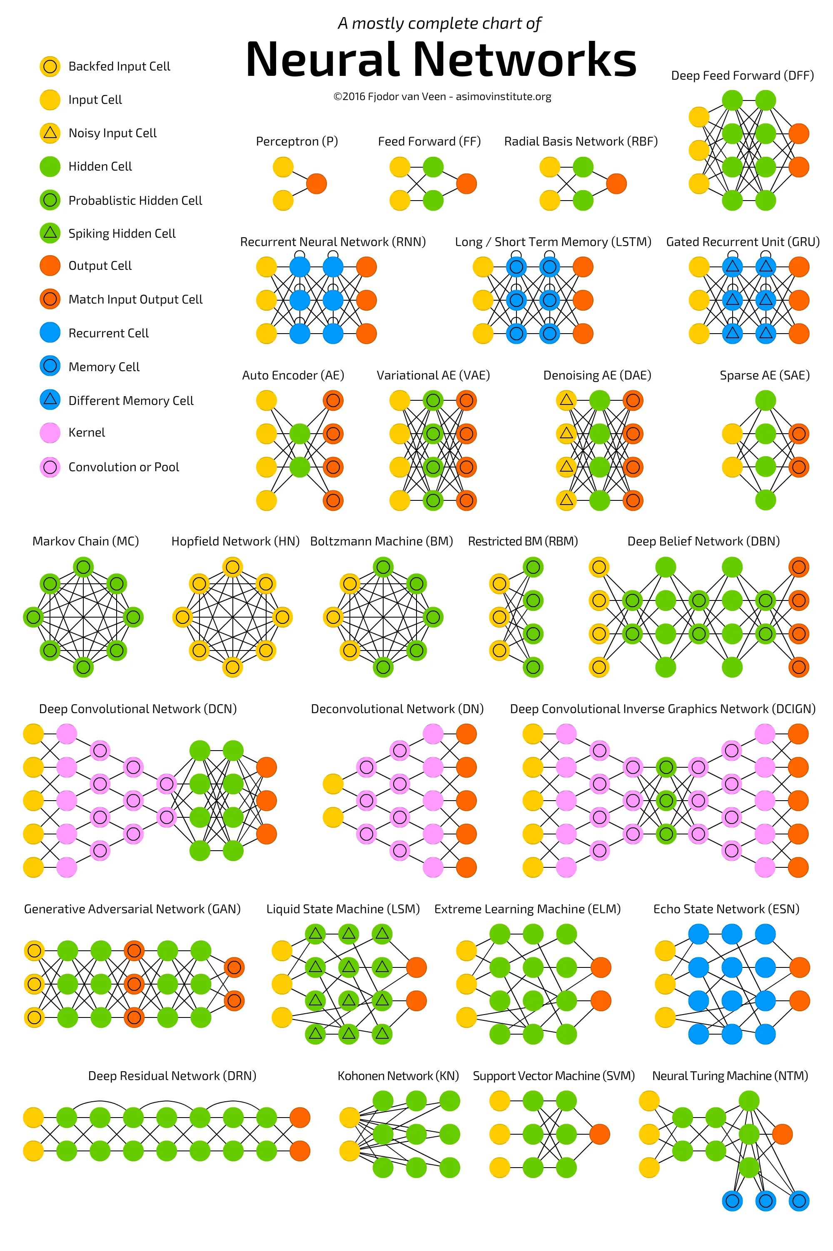
Some neural network types
”Mostly complete” in 2016, so now no longer complete.
Connections between neurons can go both ways.
Neur

